Slide 1
TRICHOMONAS VAGINITIS
Dr Shanthi Serene Sylum V
Professor and Head
Dept. Obstetrics and Gynaecology
SKHMC Kulasekharam

Slide 2
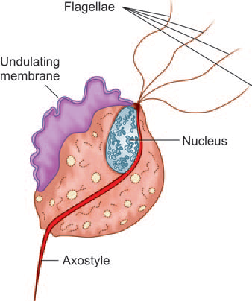
Vaginal trichomoniasis is the most common and important cause of vaginitis in the childbearing period.
Causative Organism:
It is caused by Trichomonas vaginalis, a pear-shaped unicellular flagellate protozoa.
It measures 20 μ long and 10 μ wide (larger than a WBC).
It has got four anterior flagellae and
a spear-like protrusion at the other end with an undulating membrane surrounding its anterior two third.
It is actively motile.

Slide 3
Mode of Transmission
The organism is predominantly transmitted by sexual
contact, the male harbors the infection in the urethra and prostate.
The transmission may also be possible by the toilet articles from one woman to the other or through examining gloves.
The incubation period is 3–28 days.

Slide 4
Pathology:
In about 25 percent of women in the reproductive period, the parasites harbor in the vagina in asymptomatic state.
When the local defence is impaired—during and after menstruation, after sexual stimulation, and following illness, the pH of the vagina is raised to 5.5–6.5.
At this level of pH, the trichomonads thrive.
The organisms usually lie in between the rugae and produce surface inflammatory reaction when the defence is lost.
In about 75 percent cases, the organism can be isolated
from the urethra, Skene’s tubules, or even from the
Bartholin’s glands.

Slide 5
Clinical Features
(a) There is sudden profuse and offensive vaginal
discharge often dating from the last menstruation.
(b) Irritation and itching of varying degrees within
and around the introitus are common.
(c) There is presence of urinary symptoms such as
dysuria and frequency of micturition.
(d) There may be history of previous similar attacks.
Women with trichomoniasis should be evaluated for
other STDs including N. gonorrheae, C. trachomatis,
and HIV.

Slide 6
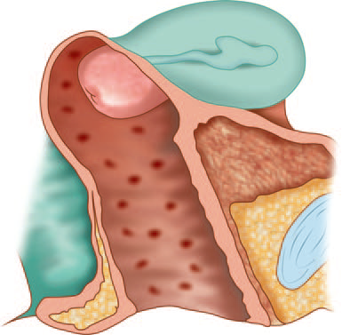
On Examination
(a) There is thin, greenish-yellow and frothy offensive
discharge per vaginum.
(b) The vulva is inflamed with evidences of pruritus.
(c) Vaginal examination may be painful.
The vaginal walls become red and inflamed with multiple punctate hemorrhagic spots.
Similar spots are also found over the mucosa of the portio vaginalis area of the cervix on speculum examination giving the appearance of ‘strawberry’

Slide 7
Diagnosis
(a) Identification of the trichomonas is done by
hanging drop preparation.
If found negative even on repeat examination, the confirmation may be done by culture.
(b) Culture of the discharge collected by swabs in
Diamond’s TYM or Feinberg Whittington medium.
In suspected cases, gonococcal or monilial
infection should be excluded.

Slide 8
Treatment
The treatment is very much effective with metronidazole.
Homoeopathic medications can be tried with symptom similarity.
The husband should be given the same treatment schedule for 1 week.
The husband should use condom during coitus irrespective of contraceptive practice until the wife is cured.

Slide 9
DC Dutta’s Textbook of Gynecology including Contraception Enlarged & Revised Reprint of Sixth Edition Edited by Hiralal Conar November 2013 JAYPEE.

Slide 10
Thank you

